Slide 1
ContractWard
Automated Vulnerability Detection
Models for Ethereum Smart Contracts
Group 5
M. Maheeth Reddy (1801CS31)
M. Nitesh Reddy (1801CS32)

Slide 2
Objective
To detect vulnerabilities in Ethereum Smart Contracts
To propose an effective and efficient method than the existing ones
To prevent huge monetary losses

Slide 3
Problem Statement
Existing vulnerability detection methods like Oyente and Securify are mainly based on symbolic execution or analysis.
These methods are very time-consuming, as the symbolic execution requires the exploration of all executable paths or the analysis of dependency graphs in a contract.
To automate the detection of vulnerabilities in Ethereum Smart Contracts using machine learning techniques.
Notes:
First, we extract bigram features from simplified operation codes of smart contracts. Second, we employ five machine learning algorithms and two sampling algorithms to build the models. ContractWard is evaluated with 49502 real-world smart contracts running on Ethereum. The experimental results demonstrate the effectiveness and efficiency of ContractWard. The predictive Micro-F1 and Macro-F1 of ContractWard are over 96% and the average detection time is 4 seconds on each smart contract when we use XGBoost for training the models and SMOTETomek for balancing the training sets.

Slide 4
Motivation
Ethereum is an open-source distributed computing platform and operating system based on blockchain, which features smart contracts.
But Ethereum is a newly developed technology. Hence it is vulnerable in terms of lacking regulations and programmable characteristics.
These vulnerabilities can be easily exploited, resulting huge losses.
For instance, the DAO bug resulted in losses of over 60 million US dollars in June 2016.
Besides, Integer Overflow bug on the BEC campaign caused instantaneous evaporation of over $900 million.
Therefore, there is a need to detect vulnerabilities in Smart Contracts before they are mined into the Blockchain.

Slide 5
Background
There are 6 types of security vulnerabilities in Smart Contracts:
Integer Overflow and Integer Underflow Vulnerabilities
Transaction-Ordering Dependence (TOD)
Callstack Depth Attack Vulnerability
Timestamp Dependency
Reentrancy Vulnerability
Bytecodes and Operation Codes of Smart Contracts are used to detect these vulnerabilities

Slide 6
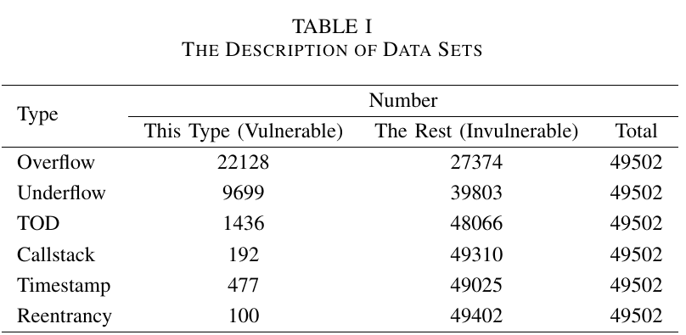
Data Pre-processing
49502 verified Solidity smart contracts are collected and labelled with the 6 types of vulnerabilities with Oyente.
Extract features that capture static characteristics of contracts from operation codes. Source codes are compiled into bytecodes and bytecodes are translated into operation codes.
Finally, ML Algorithms are used to detect vulnerabilities in smart contracts. Two sampling algorithms, Synthetic Minority Oversampling Technique (SMOTE) and SMOTETomek were adopted to balance the training data sets, as the data is class-imbalance.
To detect whether a test smart contract is vulnerable or not, five machine learning algorithms were employed:
eXtreme Gradient Boosting (XGBoost), adaptive boosting (AdaBoost), Random Forest (RF), Support Vector Machine (SVM) and k-Nearest Neighbor (KNN)
Notes:
49502 verified Solidity smart contracts are collected and labelled with the 6 types of vulnerabilities with Oyente.
We extract typical features that describe static characteristics of contracts from operation codes (opcodes) [21], since source codes of most contracts are inaccessible. Source codes are compiled into bytecodes [22] and bytecodes are translated into operation codes (opcodes).
Finally, we employ machine learning algorithms to detect vulnerabilities in smart contracts. We adopt two sampling algorithms, namely, Synthetic Minority Oversampling Technique (SMOTE) [23] and SMOTETomek [24], to balance the training data sets, as the data is class-imbalance. We then employ five machine learning algorithms, namely, eXtreme Gradient Boosting (XGBoost) [25], adaptive boosting (AdaBoost) [26], Random Forest (RF) [27], Support Vector Machine (SVM) [28] and k-Nearest Neighbor (KNN) [29] to detect whether a test smart contract is vulnerable or not.

Slide 7
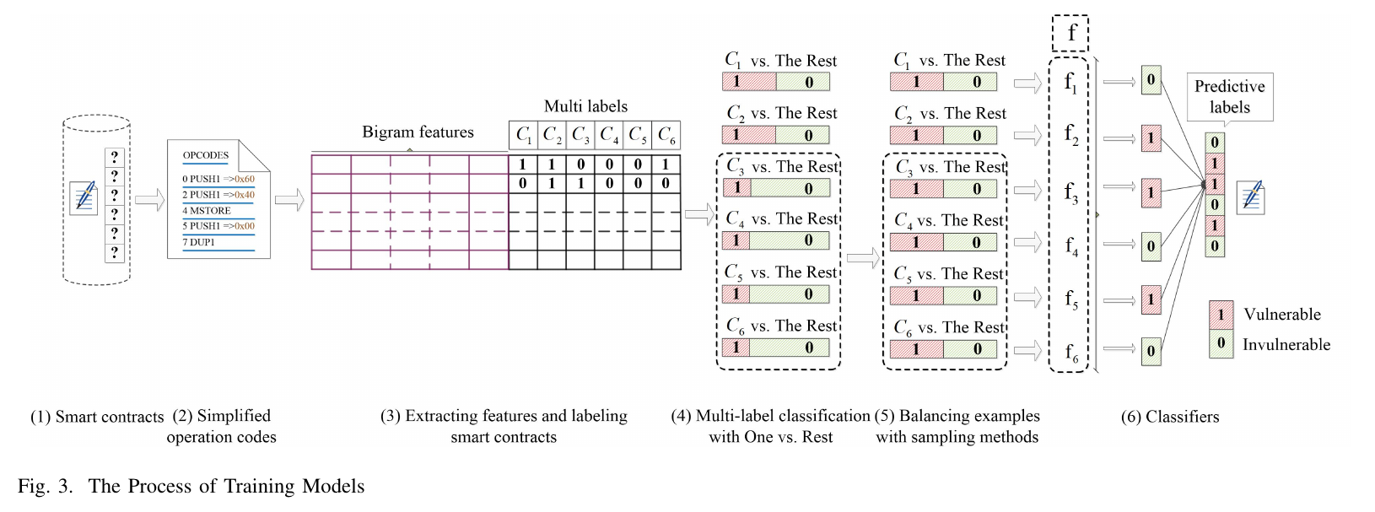
The Proposed Solution and Contribution
Notes:
First, we collect a big number of fresh and verified smart contracts from the official website of Ethereum.
Second, source codes are transformed into operation codes (opcodes) (as described in Fig. 2). Then opcodes are simplified.
Third, we extract 1619 dimensional bigram features from simplified contract opcodes and label contracts with six types of vulnerabilities (discussed in Section IV).
Fourth, we employ One vs. Rest (OvR) algorithms for multi-label classification where C1, C2, C3, C4, C5 and C6 correspond to Integer Overflow vulnerability (Overflow), Integer Underflow vulnerability (Underflow), Transaction-Ordering Dependence (TOD), Callstack Depth Attack vulnerability (Calltack), Timestamp Dependency (Timestamp) and Reentrancy vulnerability (Reentrancy).
Fifth, for balanced examples like C1 vs. the rest or C2 vs. the rest, we perform the classification directly. For the remaining four types of vulnerabilities, we need to employ sampling algorithms to balance them before classification because of class imbalance.
Finally, we build detection models on the balanced training sets for the detection.

Slide 8
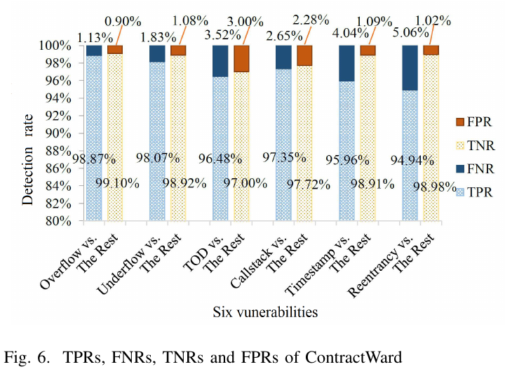
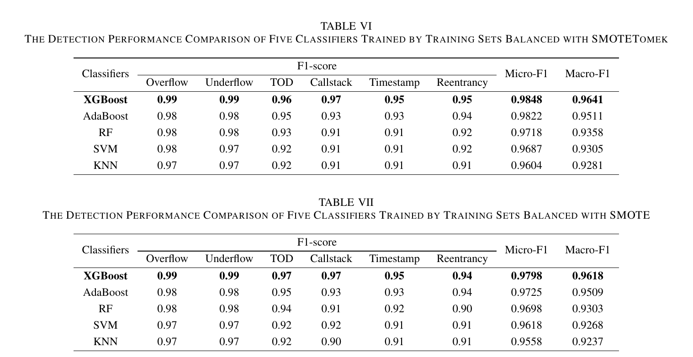
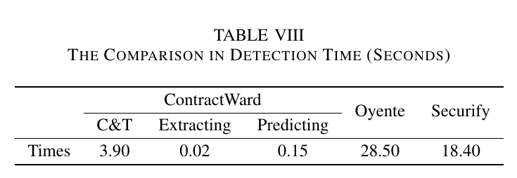
Results

Slide 9
Critical Analysis
1619 dimensional bigram features are extracted from each smart contract. These features can effectively describe the static characteristics of contracts.
Authors have also extracted unigram features and trigram features for comparison.
Unigram feature has only one operation instruction, it does not reflect the connection between instructions.
The model based on trigram features inefficient, because excessive features increase the difficulty of constructing the model and manual tuning of hyper-parameters.
Oyente detects contract vulnerabilities based on symbol execution. This requires the exploration of all executable paths in a contract and is thus time-consuming.
Securify symbolically analyzes dependency graphs of contracts, and uses these facts to match compliance and violation patterns. It is also time-consuming in constructing dependency graphs and matching patterns.
But the downside of using ContractWard is, it cannot recognize vulnerabilities that are not learned. Authors are exploring more effective features to describe the characteristics of smart contracts.

Slide 10

Thank You

